Slide 1


Mono Apartments
Iteration 2 Overview Presentation
Notes:
Dan

Slide 2

PRESENTATION INTRODUCTION
Iteration 2 System Requirements
The System Build
Our Users
Timeline
Review
Notes:
Pass to Alen

Slide 3


System Requirements - ITERATION 2
Priority 1: Further Develop the Admin Functionality for the System.
To View the inspection form as a pdf.
Inspection and Contractor management system
Send inspection requests to all contractors
Submit queries to contractors in the inspection view.
Track inspection details tied to each apartment, so each apartments inspection history can be viewed.
Priority 2: To develop deeper Contractor functionality
Inspection view allows better job management.
Contractor can more clearly view upcoming tasks.
Submit queries to admin staff.
Contractors can view their completed inspections
Notes:
Allen I am here to discuss the development priorities 1 for our management system. Our team has identified several key areas that require attention, and our top priority is to further develop the admin functionality for the system.
One of the key features that we aim to add is the ability to view the inspection form as a PDF. This will provide a more user-friendly and easily accessible format for viewing and sharing the inspection data. This is a highly requested feature, and we believe it will greatly improve the user experience.
Additionally, we are working on enabling the system to send inspection requests to all contractors. This will allow for a more streamlined and efficient process, saving time and reducing errors.
Another important development is the ability to submit queries to contractors directly from the inspection view. This will improve communication between the admin and the contractors, allowing for faster resolution of any issues or concerns.
Finally in the priority 1, we are working on tracking inspection details tied to each apartment, so that each apartment's inspection history can be viewed. This will provide a comprehensive record of each apartment's inspection history, allowing for better analysis and decision-making.
Then I will pass to Frank for priority 2.
Frank
Thanks Allen, today I would like to talk about our priority 2: developing deeper contractor functionality. Firstly, we have implemented an inspection view that allows for better job management. Contractors can now clearly view upcoming tasks that have been assigned to them after accepting a job. Meanwhile, they can submit queries directly related to an inspection description or image to the admin staff.
Secondly, we have provided contractors with a more detailed list of their completed inspections. This allows them to better understand which tasks they have completed and which ones still need to be done.
Our goal is to make the contractor's job more efficient and organized. With these new features, they can manage their tasks more effectively and improve their work efficiency.

Slide 4
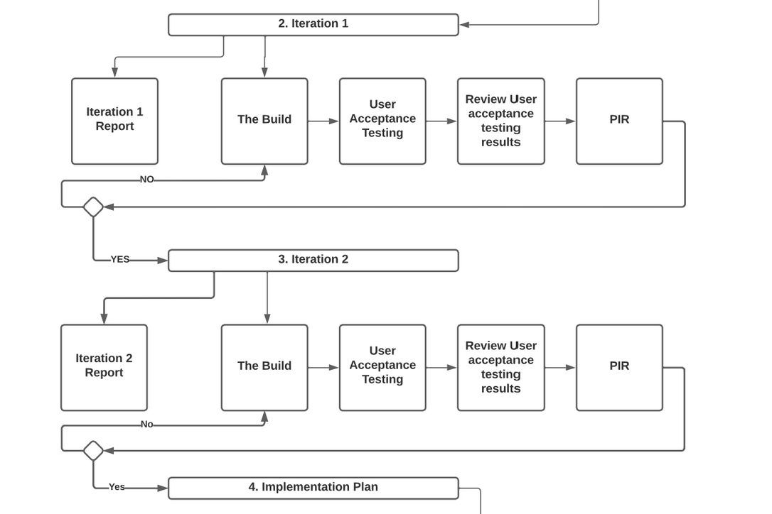
The System Build
Notes:
Dan
Discuss Iteration1 hold up
Current phase
Next parts/

Slide 5
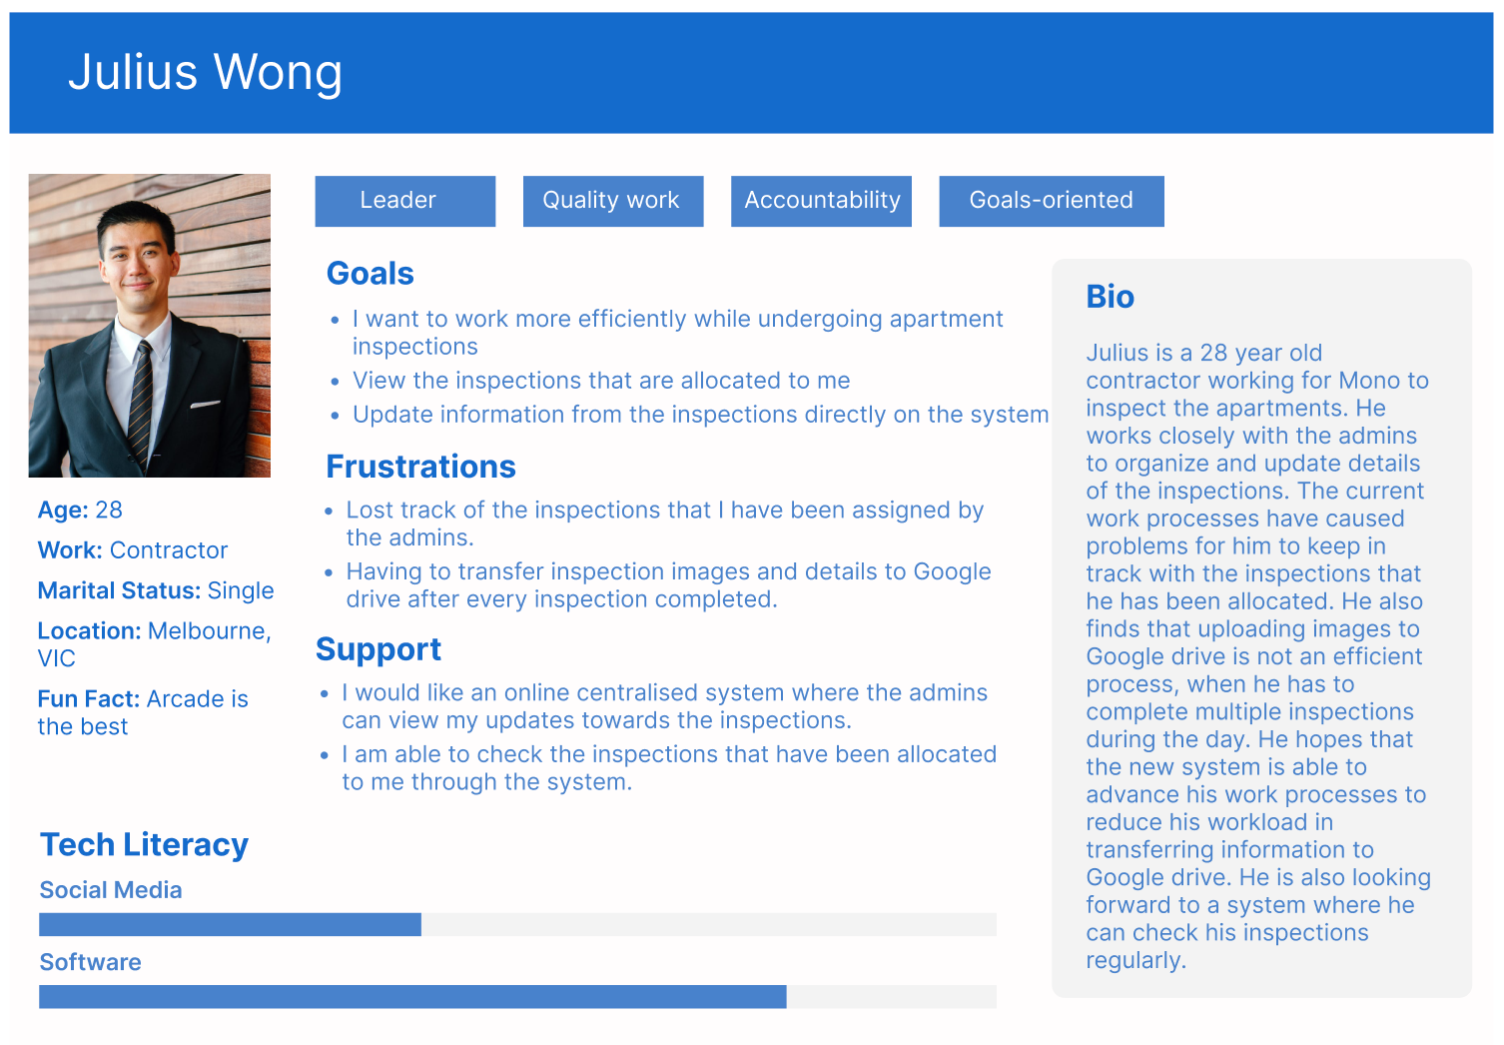
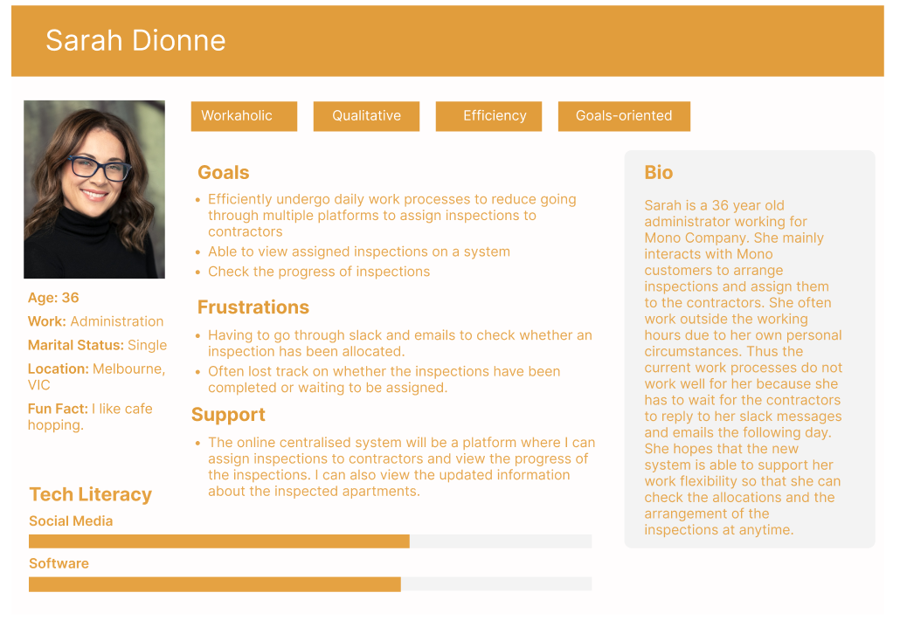
OUR EXPECTED USERS
Notes:
Cassandra Thank you Daniel
As we move onto the second iteration we are focusing on Julius and Sarah as our expected users.
They would like to have the current Mono business processes integrate into an online centralised system to support them in an efficient way of working.
Where the system could support Sarah as the admin to inspect the inspection details in a PDF format. A functionable inspection and contractor management system to be able to send inspection requests to contractors. With the system Sarah is able to view the list of inspections where she can manage them and view the updated information from the contractors
On the contractor side of the system, Julius would expect the system to help him to manage all the inspections such that he can view the upcoming inspections, view his allocation to the inspections and a list of inspections that he has completed. Where the system is able to help him track all the inspections and the details of the inspections.
Next, I will pass it to Ricardo to review the timeline on how the project will progress.

Slide 6
PROJECT TIMELINE
Business vision/overview report
Iteration 1 complete with acceptance testing
Iteration 2 report and presentation
Iteration 2 system goes live
System Handover Package
09/03
23/03
06/04
11/05
17/05
Client & Team
Team
Client & Team
Team
Team
Iteration 1
Iteration 2
Deliver
Week 1
Week 6
Week 10
Week 12
09/03
06/04
28/04
15/05
Final build acceptance Testing and Report
Client & Team
Team
Team
Client & Team
Iteration 1 presentation
Iteration 1 system goes live
Iteration 2 complete with acceptance testing
Notes:
Ricardo
Thanks Cassandra, I will now be going through our project timeline, we are now well into the project coming in onto the end of week 6, our iteration 1 will be ready to go live by the end of this week. Following on, our next iteration begins today right after this presentation. Starting next week begins our semester break for which will result in the timeline dates being pushed forward by one week. After which we will return and the project continues at the start of week 7 with iteration 2 which will be the final iteration and will be completed on the 28th of april and going live at the end of week 10 on the 11th of may.
Finally we conclude with our final build report and acceptance testing on the 15th of may followed by our complete system handover package and documentation closing out the project on the 17th of may.

Slide 7
LET’S REVIEW
Further developing admin functionality
Develop deeper contractor functionality
Create a beneficial & usable system
Notes:
Ricardo
In conclusion, our team will be further developing all aspects of the system that we have built so far for mono apartments, with the major priorities of the next Iteration focusing on the admin/contractor functionalities and fine tuning them to the level that mono admins need.
Our next iteration will result in simplifying Mono's auditing process and reducing the need for manual communication between admin and contractors, improving the efficiency and accuracy of their operations.
Importantly we want to ensure that the final system developed will be one that can easily be worked upon or converted by either mono themselves or another external team to further assists mono apartments with their business.
Thank you for listening.

Slide 8
THANKS!
Any questions?

